Slide 1
Introduction to Interactive plots using Plotly
Intro to Data Science
Judy Long | Prateek Singh | Ram Bagaria
Prof. Laura Brown
Team RED
FALL 2024
12/07/2024

Slide 2
03
05
07
08
Contents
09
10
11
13
14
15
16
Motivation
Introduction
Why Plotly?
Pre-Requisites
Installation
Crash Tutorial
Project Objective
Analysis and Visualization
Results
Conclusion
What’s Next?

Slide 3

Motivation

Slide 4
“Global warming is real. We are not getting any snow” - Ram cried wanting to see the snow
“It’s just an Urban phenomenon, made by government to scare people”, said Prateek
That triggered already irritated Ram, and the boys went into an heated argument.
Judy frustrated seeing them shouting at each other.
“Guys, we are data scientists. We can analyze some data to see if Global Warming is real or not?”
Not so keen with the idea, but both Prateek and Ram wanted to show each other down, so unwilling to agreed to this.
Finee!!! - Both exclaimed
True story!!!

Slide 5
Introduction

Slide 6


Beauty
30 interactive web based visualizations
Can be saved as HTML file
Widely used for plotting scientific, statistical and financial data
Free unless you want them to host the data
Plots are really pretty
Open Source Library
Built on JS Plotly library
Graphing Library
Publication Quality Graph
Supports Multiple Languages
Python
R
MATLAB
JavaScript
Julia

Slide 7
Why Plotly?
We wanted to use the opportunity to learn some something new
Visualization library seemed a nice idea, reason being we have been using static plot libraries for a long time
Plotly being one of the options to get into
Our objective was to create a complete crash tutorial with a real world example
The example being temperature analysis of earth’s surface to see if Global Warming is real or not?

Slide 8



Pre-Requisites
Python
Libraries (plotly, pandas)
Jupyter Notebook (or any IDE)

Slide 9
Installation
Python IDE (pip install plotly)
Conda (conda install -c plotly)
Requirements.txt file (plotly>=5.0.0)
Jupyter Notebook (!pip install plotly)

Slide 10
Crash Tutorial
So wanna see some cool graphs?
Let’s get to it >

Slide 11
Project Objective
Create basic interactive plots
Customizing plots
Changing colors, labels, and hover tooltips
Add interactivity to plots
Zooming, animation, and hover.
Mining valuable insights
From visualizations of real-world data.

Slide 12
Data Sourced from Berkeley Earth on Kaggle
Climate Change: Earth Surface Temperature Data
Perform Data Analysis and Visualization
To perform data cleaning and preprocessing them to get them ready for analysis and visualization.
User Plotly to make interactive plots
Using plotly to make insightful interactive plots on data to get any conclusive results
Global warming is real or not?
Answering questions like, Is global warming real, did earth temp actually increased, if yes then when did it start?
Demonstrate our learning from Tutorial
To demonstrate what we learned from tutorial, and apply them on a small scale real-world project.

Slide 13
Analysis & Visualization
Country Temperature Analysis
Notebook >
City Temperature Analysis
Notebook >
Surface Temperature Analysis
Notebook >

Slide 14
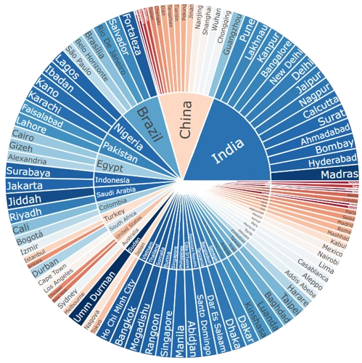
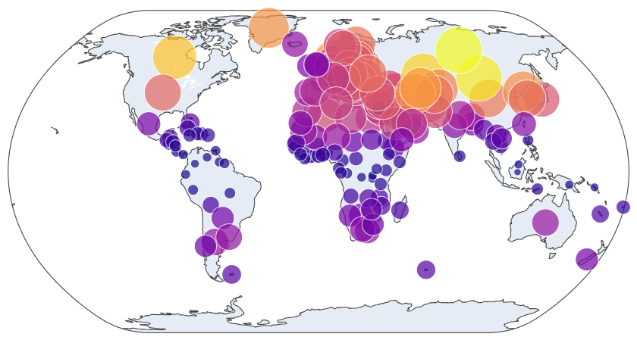
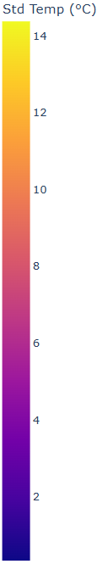
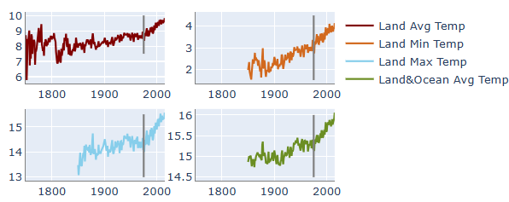
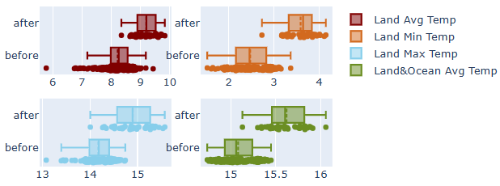
Results
The time series line plot demonstrates a clear upward trend especially after 1975, indicating a consistent increase in temperature over time.
Significant average temperature shift before/after 1975
Line Chart
Sunburst Chart
Animation Map
Box Plot
Map
Availability of data fluctuates across different regions
Temperature change exhibits varying degrees of impact across regions.

Slide 15
Conclusion
Plotly offers multiple visualization techniques that enhance data understanding. Its interactivity and animation features make it easier to explore and uncover underlying patterns and insights from the figures.
The change in average temperature before and after 1975 highlights a significant shift, indicating that global warming has intensified notably since 1975.
After 1975, compared to countries near the equator, those at higher altitudes exhibit greater temperature standard deviations, indicating more pronounced variability. These regions are particularly vulnerable to climate change due to their sensitivity to temperature fluctuations and associated environmental impacts.

Slide 16

What’s Next ?
Animations in Plotly
Use Dash to integrate Plotly visualizations to make beautiful dashboards
Integrate Plotly with other web frameworks like Flask or Django to create interactive web apps
Explore Plotly's cloud features to host data, deploy web apps, integrate with other cloud vendors

Slide 17
Thank You

